Slide 1
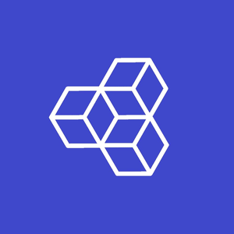





Anvpy Developers
Group
PRESENTS
<ANVPY>
Ctrl+Shift+Create
www.anvpy.com

Slide 2
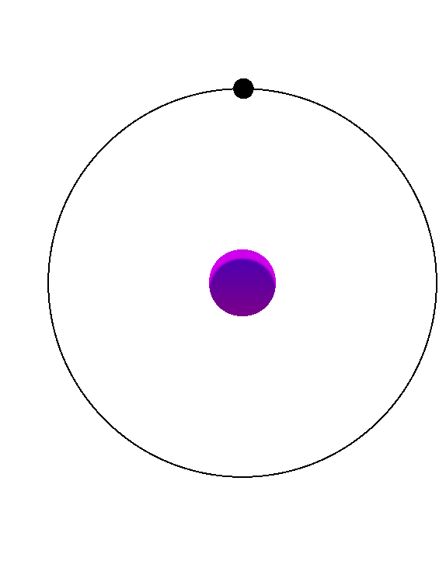
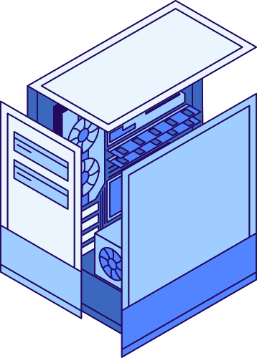
PROBLEM STATEMENT
Anvpy
In Order to build a sample application for Android platform in python using traditional Way ( Ubuntu/Colab) it requires almost 40-55 minutes.
Bulk AI/ML packages like that of PyTesseract and MediaPIPE are not normally available For use in normal build process as there is no recipy( instructions ) available for them.
Other packages like that of OpenCV, Matplotlib, Pandas, Scipy requires a lot of build Options and dependencies, which sometimes requires custom recepies.
It is not possible in traditional way to access all Android native features like that of accessing hardware sensors or software components like that of Android accessibility or Android Application Package System.

Slide 3
Anvpy
With the help of AnvPy apps can be build within 15-20 seconds.
Modules like Pytesseract, Tenserflow, PyTorch, Keras, MediaPIPE are available in AnvPy.
Pre-built binaries of NON POSIX-based bulk modules that takes more time to build is available .
Users have the authority to cosolidate all Android Hardware and Software components including sensors and System Software.
KEY
SOLUTIONS

Slide 4
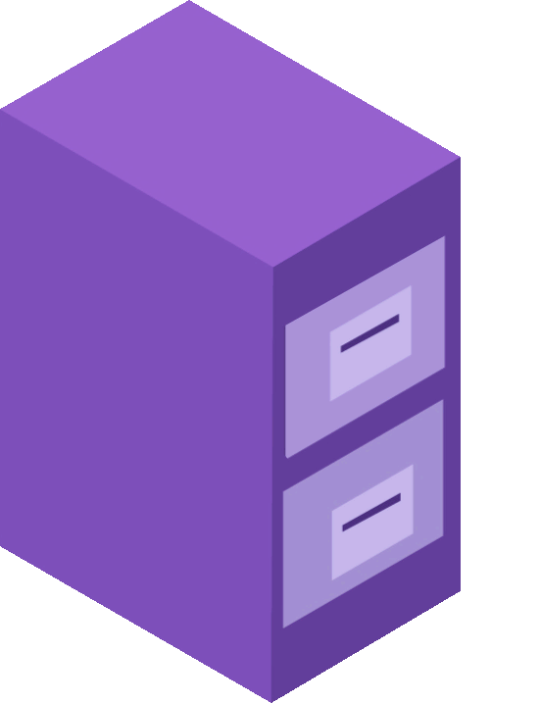
AnvPy
PROGRAMMING
LANGUAGES/SOFTWARE”S
Python
Java
JavaScript
C++
HTML5
>

Slide 5

SOLUTION ENGINEERING
Anvpy
Anvpy contains built-in Code Editor that makes it a complete suitable environmentfor running and testing Apps directly from your Phone.
Currently AnvPy supports APP Development, Game Development, PWA( Progressive WebApps ), LOGO (Language of Graphics Oriented).
It has theme manager, samples which act as a reference to build apps related to computer vision(opencv) or graphs(matplotlib) , etc

Slide 6
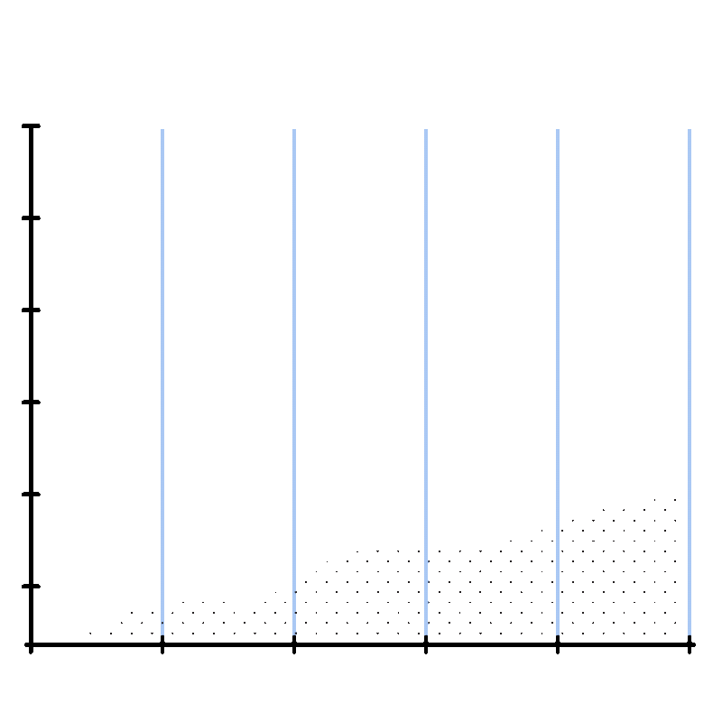
Anvpy
JUST A
THOUGHT
Graph showing people will love python after knowing they dont have any limits <>
Today
Tom
DAT
Future

Slide 7
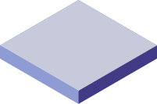
AnvPy
ARTIFICIAL
INTELLIGENCE
Artificial Intelligence (AI) packages like pandas, scipy , matplotlib, etc... or computer vision packages like opencv , pytessaract , mediapipe ,etc... which are only limited to computer devices can be implemented flawlessly to mobile devices using Anvpy , Thus bringing its complete potential .

Slide 8
CROSS-PLATFORM
AnvPy
Due to the stability of AnvPy , apps made using it are cross-platform i.e it can run on any device irrespectve of any operating system(O.S) ,
Like android , ios , windows , macintosh, Linux , even raspberry pi too.
So here we are writing a single code snippet which can run the app anywhere irrespective of any OS which cuts the requirement of additional developers for each O.S .

Slide 9



Anvpy Developers
Group
THANK YOU!
+91 7750055149
www.anvpy.com
techanvpy@gmail.com

